Slide 1
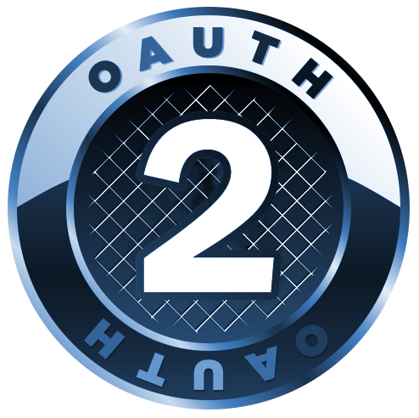
Why you should care about OAuth2
Justin Richer
Innovation Brown Bag
September 23, 2011

Slide 2
What is OAuth?

Slide 3
OAuth Is
An Open Authorization protocol
Not single sign on
Built for user-delegated API access
But useful for many different things
Widely deployed across the internet
Going to take over the world*
*Presenter’s opinion

Slide 4

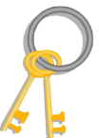


A Scenario
Hi
A user
A Client Site
A Service Provider Site

Slide 5
The Problem
Go get my data from over there
?
Notes:
User wants to access one site *through* another. Site needs to act on behalf of a user.

Slide 6
How do you bridge the gap?

Slide 7

The Single-Sign-On Approach
Hey, give those back!
That’s not my account on there.
?
Notes:
We just hand the user’s credentials over to the far site and try them out. This makes the user nervous, as it’s basically a benevolent man-in-the-middle attack. Plus, it only works if everyone’s using the same user authentication system.

Slide 8

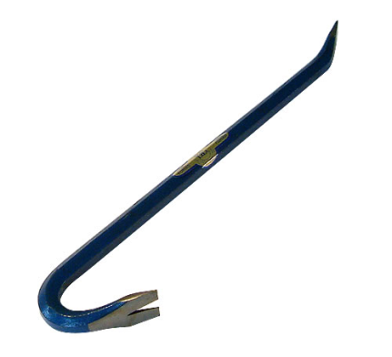
The Developer Key Approach
Hey, I never told you to do that!
!
Notes:
We let one site in with a universal key, and trust them when they say they’re working on behalf of a user.

Slide 9


The Give-Me-Your-Keys Approach
Please be nice
Notes:
We outright ask the user for their username and password to the remote site. Eeep.

Slide 10
There has to be a better way to do this…

Slide 11


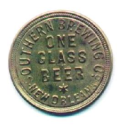
The OAuth Approach
?
+
+
=
Notes:
Using OAuth, we get a token that the user has to verify before it’s any good to us. Then we can use the API as long as that token stays valid.

Slide 12
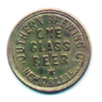
OAuth Tokens Grant Access
=
Notes:
Once we’ve got our access token, we don’t have to make the user re-authenticate us to the far server. We also never need to know the user’s remote username.

Slide 13
Key Points
User’s credentials are never transferred between servers
Works across security domain boundaries
No need for trust-all developer keys
Token can be rotated and revoked
Independent of passwords or other credentials
All over HTTP
Built to work with RESTful application approaches

Slide 14
OAuth 1.0 & OAuth 1.0a
Some history

Slide 15

The Beginning
November 2006
Twitter, Ma.gnol.ia, and others want to use OpenID to connect between services
OpenID Can’t close the bottom of the triangle
?

Slide 16
State of the Practice
Others had tried to solve this problem
FlickrAuth (Flicker)
AuthSub (Google)
BBAuth (Yahoo)
Tokens replace direct credentials
Explicit user consent
Crossing trust domains

Slide 17

Standardization
Take the best practices and experience from existing solutions together into one protocol
Thus: OAuth 1.0
Revisions
1.0a closed session fixation attack
RFC 5849 cleaned up editorial language
Standard libraries for authorization
In any language you can think of

Slide 18
OAuth 2

Slide 19
Built on Experience
OAuth 1.0 tried to solve many problems at once with a single solution
OAuth WRAP tried to solve a slightly different problem set in a novel way
Solution: divide the problem space and combine the approaches
Methods for getting a token
Methods for using a token to get stuff
Methods for signing an HTTP request
Not backwards compatible
But both versions can co-exist

Slide 20
OAuth2 is not wire-compatible with OAuth 1
Note Well:
(This is on purpose)

Slide 21
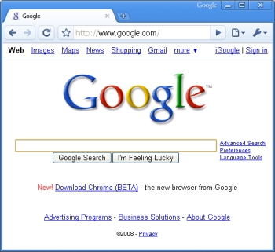

OAuth 1 Concepts
Request Token
(Lets client ask for access tokens)
User
(Owns stuff)
User Agent
(Web browser)
Access Token
(Lets client get stuff)
Client/Consumer
(Wants stuff)
Server/Provider
(Has stuff)

Slide 22
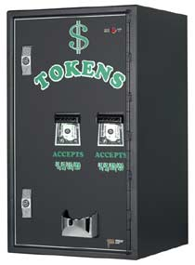
OAuth 2 Concepts
Refresh Token
(Lets client ask for access tokens without bugging the user again)
User
(Owns stuff)
User Agent
(Web browser)
Access Token
(Lets client get stuff)
Client
(Wants stuff)
Protected Resource
(Has stuff)
Authorization Server
(Issues tokens)

Slide 23
New to OAuth 2
Different token styles
Use bearer tokens over SSL without signatures
Use MAC tokens for signing
Scope
What is this token good for?
Provisions for re-scoping requests
No more request tokens
They were a hack in the first place

Slide 24
Also New to OAuth 2
Multiple token flows for different client types
Higher flexibility for deployment
Refresh tokens
Allows for easy rotation of access tokens
Conceptual separation of protected resource and authorization server
Can still be combined (and often are) in one box
Extensibility and error handling
Clear paths forward

Slide 25
Making OAuth2

Slide 26
IETF Working Group
Connected by freely-joinable mailing list
Very low barrier of entry
#angrynerds
Works on rough consensus
Preference towards demonstrated functioning code
International and cross-industry participation
Chartered in 2009
Originally to make OAuth 1.1

Slide 27
Timeline of OAuth2
2-Legged OAuth
MAC Token
OAuth 1.0
OAuth 1.0a
RFC 5849
OAuth2 Core
OAuth2
2010
2011
2007
2009
2010
Bearer Token
OAuth WRAP
JWT, JWS
OpenID Connect
SWD
Dynamic Registration
UMA
SAML Binding
…
2009

Slide 28
Current Draft Status
Draft 22, results of working group last call
As of September 22, 2011:
Submitted to IETF as a Proposed Standard
RFC Sometime in early 2012
Bearer, MAC, and SAML-binding drafts also going forward now
Security Considerations document to follow
http://tools.ietf.org/html/draft-ietf-oauth-v2-22

Slide 29
OAuth 2 Protocol Flows

Slide 30
OAuth2 Endpoints
Token endpoint
Where authorization server issues access tokens
Authorization endpoint
Where the client sends the resource owner to authorize the token request
Extensions can define new endpoints
e.g., Revocation endpoint

Slide 31
Authorization Code
Traditional three-legged OAuth flow
Best path for web-server-based clients
Also good for native clients
Authorization server issues a one-time-use code through the user agent to the client
Via the authorization endpoint
Makes use of back-channel
Client trades access code for a token directly at token endpoint

Slide 32
Refresh Tokens
Can be issued alongside of access tokens
Allow for rotation of access tokens without asking the user again
Client calls token endpoint directly
Can have different expirations
Refresh token: long grant, saved by client between sessions
Access token: short grant, deleted at end of session
Can have different scopes
New access tokens must have equal or lesser scope

Slide 33
Implicit
Best path for in-browser clients
Registered callback URL helps authenticate client
Client gets the token directly from the authorization endpoint
Saves a round-trip
Can’t use refresh tokens
No good place to store them yet
Should use short-lived access tokens

Slide 34
Username/Password
Bootstrap old password-based systems
Until they disappear
Client prompts user for username and password
Client presents those directly to token endpoint
User authorization is implied through provision of username and password

Slide 35
Client Credentials
Client authorizes a transaction directly
Not on behalf of a particular user
Client connects directly to token endpoint and retrieves access token
Refresh tokens are allowed
But don’t make much sense

Slide 36
OAuth on Two Legs

Slide 37
Server-to-Server

Slide 38
Why two legs?
Limit exposure of credentials
Use credentials to get tokens
Use tokens for access
Make use of scoping and delegation
Can separate authorization server from protected services
Parameter and value assurance via signatures
Without requiring a body-signing protocol
Light-weight protocol

Slide 39
Two-legged OAuth 1.0
Use OAuth signatures without tokens
Client credentials as pre-placed keys
Sign all components of HTTP message
Verify signature on completion
Never an intended use of OAuth
But very useful!

Slide 40
Two-legged OAuth 2
MAC token signing
Sign requests using client credentials
Similar to OAuth 1.0 use
Client credentials flow
Periodically trade client credentials for a token
Keep access tokens short-lived and limited in scope

Slide 41
Off the Web
Native clients with OAuth

Slide 42
Native Clients
Can’t store client passwords securely
BUT: Can store tokens securely
Rely on browsers for user authentication
Embedded or external application
Must support callback of some kind
Embedded web server (http://localhost/)
Custom scheme (app://oauth)
Hosted callback landing page

Slide 43
Why use OAuth here?
Clients don’t have to store sensitive user credentials (passwords)
Clients never even have to see the password!
Misbehaving clients can be revoked by users
Works with systems that don’t use passwords
e.g., OpenID websites

Slide 44
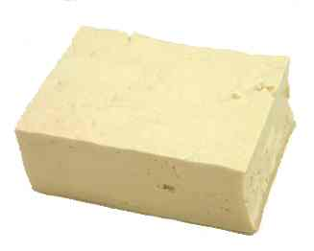
TOFU
It’s good for you!

Slide 45
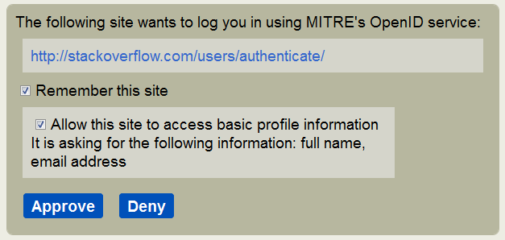
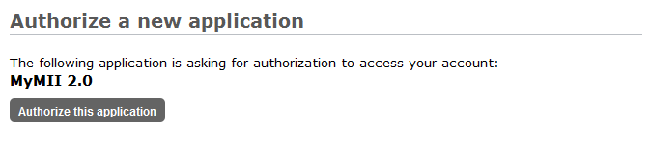
Trust on First Use
First time through, ask:
“You’ve never allowed this before. This is what I can say about them, is that OK?”
Subsequent times through:
“I’m reasonably sure this is the same thing that you’ve said OK to before, let it through”

Slide 46
Trust Layers
Whitelist
Trusted partners, business contracts, customer organizations, trust frameworks
Graylist
User-based trust decisions
Follow TOFU model, keep logs
Organizations decide these
End-users decide these
Blacklist
Very bad sites we don’t
want to deal with, ever

Slide 47
Where OAuth 2 is Going

Slide 48
Current Deployment
Basis for many new APIs
Google+ API
Facebook Graph API
SalesForce Force.com API
37Signals API
Library implementations
Spring Security OAuth (Java Spring)
Apache Amber (Java)
iOS
Ruby
Python

Slide 49
Use at MITRE
PuSHEE
RESTful publish/subscribe system
MITRE Profile server
PortableContacts formatted information on all MITRE employees
hData authorization
hQuery distributed authorization

Slide 50
OpenID Connect
Identity system built on top of OAuth 2
Adds provisions for:
Profile information
Discovery
Dynamic registration
Session management
Leverages other emerging technologies
JWT, JWS, SWD
Set to be adopted by Facebook, Google, and others
Including MITRE in FY12

Slide 51
UMA
User-Managed Access
Kantara Initiative project
Give users full control over access to protected resources
Adds access manager component
Governs access decisions based on user policy

Slide 52
OAuth 2 and SAML
They’re not mutually exclusive
SAML Bindings for OAuth 2 working group item
They can work together!
Authenticate users and clients with SAML
Use OAuth 2 to more easily integrate SAML with RESTful apps
Pack SAML into OAuth2 tokens
Protected resources can check signatures and other content

Slide 53
Conclusions

Slide 54
Why Should You Care About OAuth 2?
It solves many common problems
Even some you didn’t know were problems
Many parts of industry are behind it
Facebook, Google, Yahoo, Twitter, Microsoft, AOL, Yahoo, Deutsche Telekom
We can innovate with its application

Slide 55
Welcome to the Future
OAuth 2 is the major authorization protocol for the web in the next five years
Extensions and flexibility could mean longer
OAuth 2 is set to bridge enterprise and internet technologies
Use the same stuff inside and out
OAuth 2 will live well beside other technology
SAML, OpenID

Slide 56
http://oauth.net/2
For more information, check the website

Slide 57
Thank you
jricher@mitre.org

